Slide 1
Selecting a perfect location to open a coffee shop in Puducherry
by
Chanthiraprabu B S

Slide 2
Introduction
Puducherry is a union territory in India. If someone is looking for a place to open a coffee shop, the biggest problem would be where it should be? I will analyze the city using data science techniques learn in this course to find the best place to open coffee shop.

Slide 3
Data
The data is about geolocation which is collected from FourSquare. Data contains location of the coffee shop in Puducherry. Explanation of the location data is a standard tuple (lat, lng), where lat stands for latitude and lng for longitude. Also name,shortname,formattedAddress and postalcode are collected.

Slide 4
Methodology
Data will be used in the following way: by knowing the locations of already existing cafes, it's possible to apply unsupervised learning technique like kernel density estimation (KDE) to determine the area of influence of the existing cafes, and start up new coffee shop which is not in the area of influence.

Slide 5
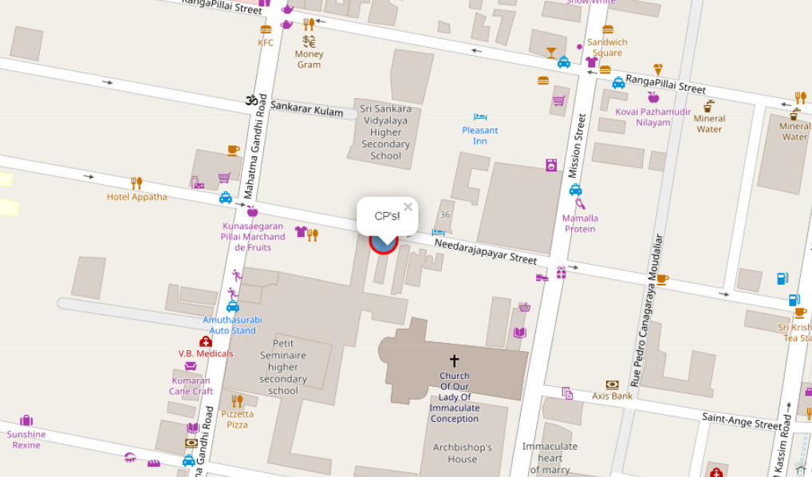
Results
As you can see, one possibly good location for new coffee shop would be in Needarajapayar street.

Slide 6
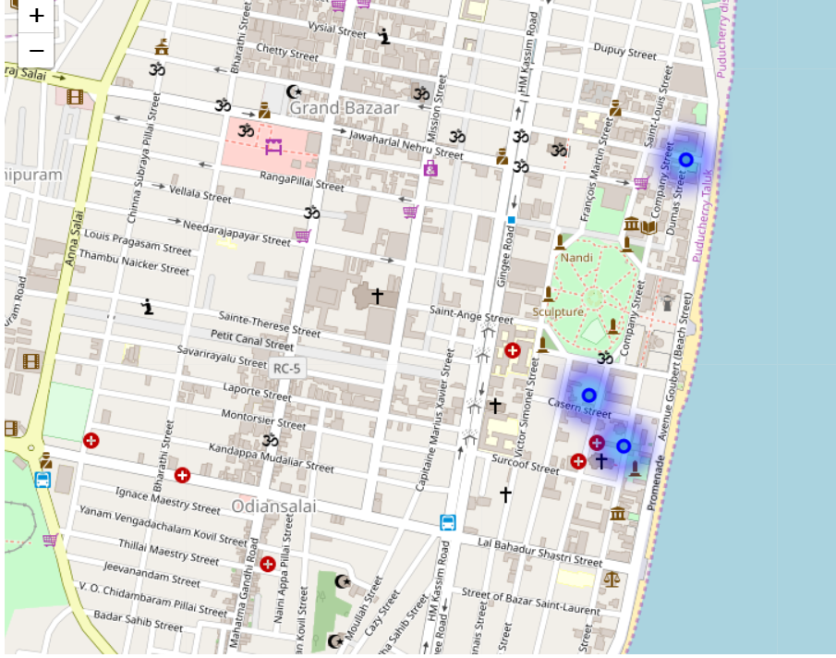
Discussion
As we see the heat map, the coffee shops are mostly present near to the seashore area. We can further change the parameters passed to find more locations where it will be optimal to open the coffee shop.

Slide 7
Conclusion
Data science is a great methodology or technique , that will solve our problems easily which will actually consume a lot of time and hard work.

Slide 8
Thank you

